Slide 1
DOM
29 May 18 | Start
02 Jul 18 | 1: 4-9
Appendix
Online

Slide 2
DOM
Ch | Date
1 | 00 May 18
2
3
4
5
6
7
8
9
10
11
12
DOM Enlightenment 02 2013

Slide 3
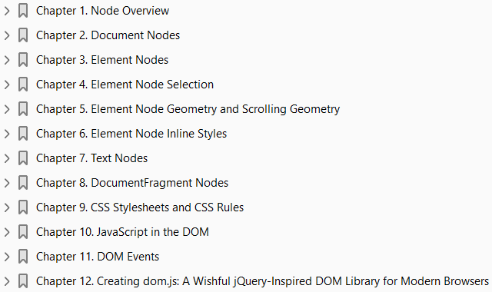

Slide 4
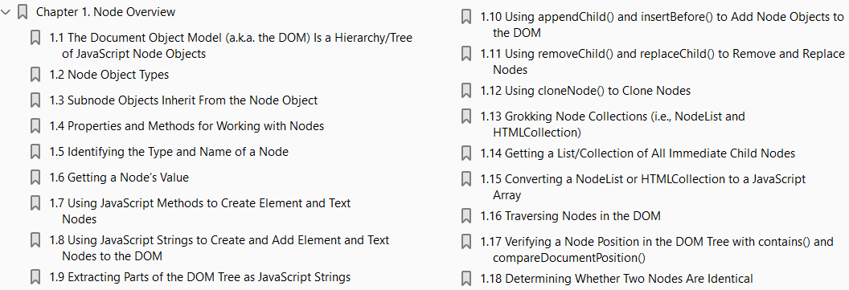
1
Node Overview

Slide 5
DOM
The Document Object Model (a.k.a. the DOM) - Is a Hierarchy/Tree of JavaScript Node Objects
When you write an HTML document, you encapsulate HTML content inside other HTML content.
By doing this, you set up a hierarchy that can be expressed as a tree.
Often this hierarchy or encapsulation system is indicated visually by indenting markup in an HTML document.
The browser, when loading the HTML document, interrupts and parses this hierarchy to create a tree of node objects that simulates how the markup is encapsulated: Figure 1-0.
The preceding HTML code, when parsed by a browser, creates a document that contains nodes structured in a tree format (i.e., DOM).
In Figure 1-1, I reveal the tree structure from the preceding HTML document using Opera’s Dragonfly DOM Inspector.
On the left, you see the HTML document in its tree form.
And on the right, you see the corresponding JavaScript object that represents the selected element on the left.
For example, the selected <body> element, highlighted in blue, is
an element node and
an instance of the HTMLBodyElement interface

Slide 6
DOM |
What you should take away here is that HTML documents get parsed by a browser and converted into a tree structure of node objects representing a live document.
The purpose of the DOM is to provide a programmatic interface for scripting (removing, adding, replacing, eventing, and modifying) this live document using JavaScript.

Slide 7
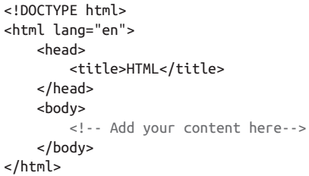
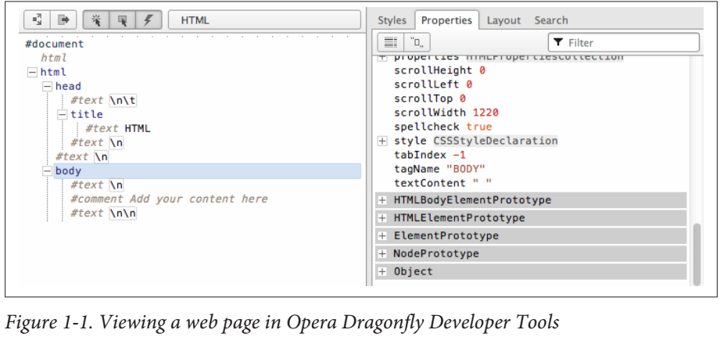
Figure 1-0 || 1-1

Slide 8
Note
The DOM originally was an application programming interface for XML documents that has been extended for use in HTML documents.

Slide 9
Node Object Types
Here is a list of the most common types of nodes (i.e., nodeType/node classifications) one encounters when working with HTML documents:
DOCUMENT_NODE (e.g., window.document)
ELEMENT_NODE (e.g., <body>, <a>, <p>, <script>, <style>, <html>, <h1>)
ATTRIBUTE_NODE (e.g., class="funEdges")
TEXT_NODE (e.g., text characters in an HTML document including carriage returns and whitespace)
DOCUMENT_FRAGMENT_NODE (e.g., document.createDocumentFragment())
DOCUMENT_TYPE_NODE (e.g., <!DOCTYPE html>)
I’ve listed the node types formatted (all uppercase, with _ separating words) exactly as the constant property is written in the JavaScript browser environment as a property of the Node object.
These Node properties are constant values and are used to store numeric code values that map to a specific type of node object.
For example, in the following code, Node.ELEMENT_NODE is equal to 1.
And 1 is the code value used to identify element nodes.

Slide 18
2

Slide 19
document Node Overview
The HTMLDocument constructor (which inherits from document) creates a DOCU MENT_NODE (i.e., a window.document) in the DOM. To verify this, I can simply ask which constructor was used in the creation of the document node object.
(Page 31).

Slide 29
3

Slide 30
Intro

Slide 31
4

Slide 32
Intro

Slide 33
5

Slide 34
Intro

Slide 35
6

Slide 36
Intro

Slide 37
7

Slide 38
Intro

Slide 39
8

Slide 40
Intro

Slide 41
9

Slide 42
Intro

Slide 43
10

Slide 44
Intro

